Slide 1
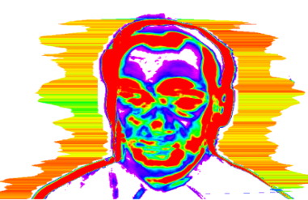
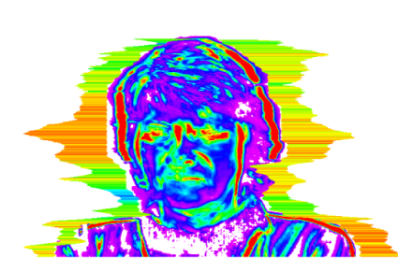
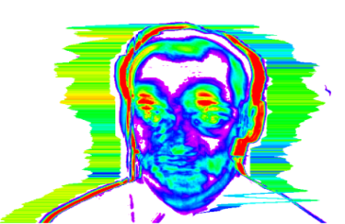
EFFECTIVENESS OF DRUMMING'S EDUCATIONAL TRAINING BY VIBRAIMAGE PSYCHOPHYSIOLOGICAL PARAMETER ANALYSIS
VIBRASAYSTEM

Slide 2
Research condition
Total teestes : 47 students (Middle school)
- Female : 35 students
- Man : 12 students
Average age : 14.2 years (Standard deviation :0.74)
Researching team :
- SEROTONIN Lab.
- VIBRASYSTEM
Training center : National Youth Training Center in South Korea

Slide 3
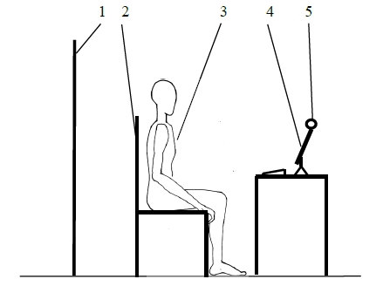
Researching Objective and condition
To compare the effectiveness by finding differences in meaningful
Psycho-physiological parameters measured from VIBRASYSTEM in
two states of each subject group.
Condition 1 : Pre-training state (Before training)
Condition 2 : Post-training state (After training)
Experiment environment
1 – Screen background,
2 – Chair,
3 – Experimental testee,
4 – PC,
5 – Web camera
Testing period : 1 minute

Slide 4
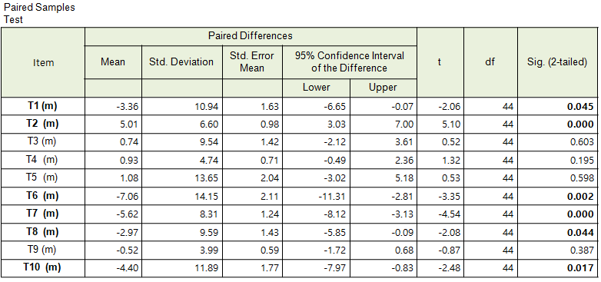
Mean(M) Value of comparative statistical analysis

Slide 5
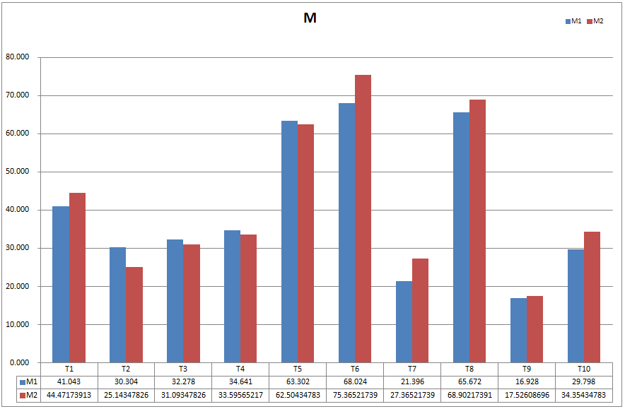
Mean(M) of Before / After comparison

Slide 6
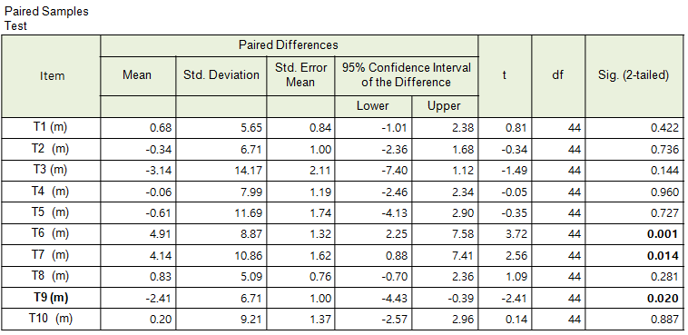
Variability (Vi) of Before / After comparison

Slide 7
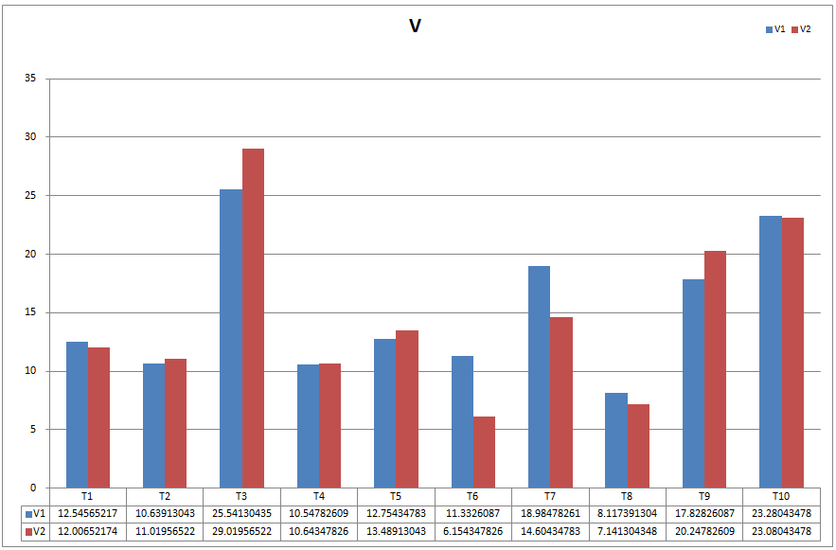
Variability (Vi) of Before / After comparison

Slide 8
Comparison of Vitality, Psychology Energy, Stability

Slide 9
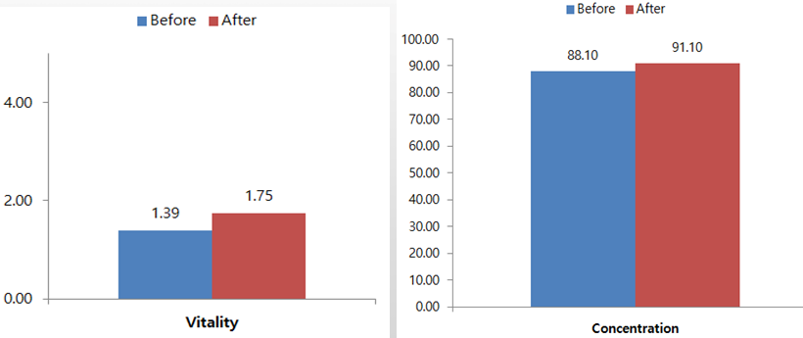
Comparison of Vitality, Concentration

Slide 10
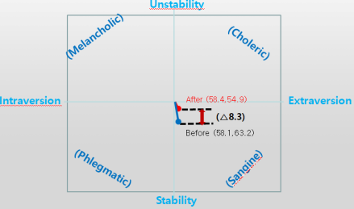
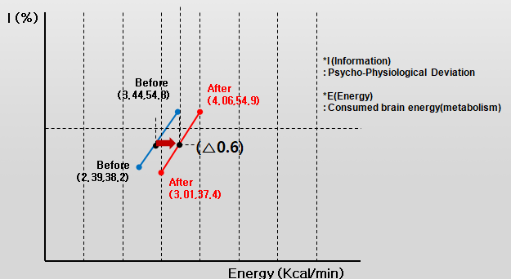
Comparison of Stability and Mental energy
Stability
Mental energy

Slide 11
Conclusion in Effectiveness and Difference
The effectiveness of drumming's education and training is
1) To let students be very positive in various psycho-physiological conditions
2) Proved to be very effective
3) Vitality and Concentration is increased so much
4) Non-contacting method
5) Easy and convenient measurement
6) Objectively and efficiently identify changes in all functional conditions
The differences between the two conditions are remarkably marked by psycho-physiological parameters.
The significant differences were so evident in T1(Aggression), T2(Stress), T6(Charisma), T7(Energy), T8(Self-Regulation) , T10(Neutrocism).

